Slide 1
International Admissions Rating Algorithm - IARA
Khushi Panchal & Steven Bennett

Slide 2
Introduction
Decision-support system for internation applicant evaluation
Designed for WSU International Programs admissions
Evaluates applicants using scoring, AI analysis, and document checks
Team roles:
Khushi Panchal - Full-stack development, scoring engine, UI, database
Steven Bennett - Fraud detection, backend integration, deployment
Sprint 6 focus: final implementation, deployment, and client delivery

Slide 3
Sprint 6 Goals & Objectives
Finalize system features and integration
Deploy application to a live environment
Validate end-to-end workflow functionality
Prepare system for real-world deployment
Deliver final product to client

Slide 4
Feature Implementation & Demo
Core workflow: scoring, essay analysis, fraud detection, reporting
Batch processing for multiple applicants
Analytics dashboard for insights and trends
End-to-end functionality in deployed system

Slide 5
System Deployment
Platform: Microsoft Azure (App Service, Container)
Deployment: Manual container-based deployment
Live System: http://iara-app-25.azurewebsites.net/login
Client Feedback: Collected during final system walkthrough
Testing Results:
Core features validated (analysis, scoring, reporting)
Stable performance on Azure deployment
Interface designed for simple and intuitive use

Slide 6
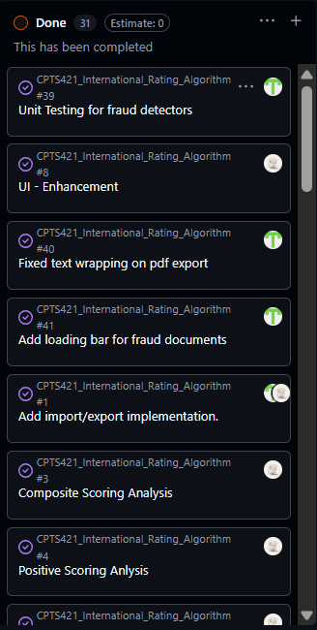
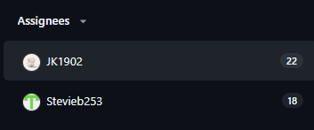
Kanban Review
Completed sprint tasks and backlog items
Progress tracked through Kanban workflow
Tasks distributed across team members

Slide 7
Client Communication
Meetings with stakeholder, Trevor Kingsley, via Teams
Mom documented in GitHub: MoM Github
Feedback incorporated into system design and features
Key decisions:
Defined scoring model and evaluation criteria
Added fraud detection and essay analysis features
Approved dashboard updates and deployment direction

Slide 8
Documentation and Final Report
Handover Document: IARA_Handover_Document
Final Report: CptS423 - Final Report

Slide 9
Responsible Use of AI
ChatGPT and Claude assisted with debugging, documentation, and deployment guidance
All outputs reviewed and validated before use
Limitations Recognized: occasionally addressed symptoms rather than root causes, manual verification required
Final implementation and decisions remained team responsibility

Slide 10
Sprint Achievements and Challenges
Achievements:
Completed full system integration and workflow
Successfully deployed system to a live environment
Delivered final client-ready application
Challenges:
Code restructuring for deployment (container/cloud)
Memory limitations during hosting
Solutions:
Refactored system for deployment compatibility
Adjusted deployment approach to improve stability

Slide 11
Sprint Retrospective
What Worked Well:
Strong system design and feature integration
Successful deployment to a live environment
Clear project vision and functionality
What Could Be Improved:
Earlier alignment on final delivery expectations
More structured feedback cycles during final stages
Lessons Learned:
Importance of continuous client communication
Real-world deployment introduces new challenges
Agile process requires consistent iteration and feedback

Slide 12
Conclusion & Handover
Fully developed and deployed decision-support system
Validated end-to-end functionality in live environment
Ready for real-world deployment with minimal configuration
System prepared for client handoff and future integration
Thank you to our professor Parteek Kumar and our stakeholder Trevor Kingsley.

